Slide 1
ITSC 206: Advanced Networking for Offensive and Defensive Environments
Lecture 1: Fundamentals of Network Security
Notes:
PLEASE READ SLIDE NOTES

Slide 2
Table of Contents
Intro
Course Grading
Communication / Attendance
Network Review
Network Security
Threats
Defenses (Defense in Depth)
Wired vs Wireless Networks
Network Vulnerabilities
Security Toolbox

Slide 3
Intro
Instructor – Viktor Lyagutsky
Background
Class
Each student

Slide 4
Course Grading
Labs x 8
Quiz x 7
Mid Term Exam
Final Exam
15 %
10 %
35 %
40 %

Slide 5
Communication / Attendance
Instructor to Student
Email
Pre and post class (15 min)
During lecture / lab
Student to Instructor
Email pre and post class
Schedule appointment
Class/Lab/Quiz/Exam Attendance
Flexibility but communication is key

Slide 6
Network Review

Slide 7
What is a Network
A network is an interconnection of three or more communicating entities
A number of nodes connected by some sort of communications path
This can include but not limited to Ring, Dual Ring, Tree, Mesh, Bus, Star

Slide 8
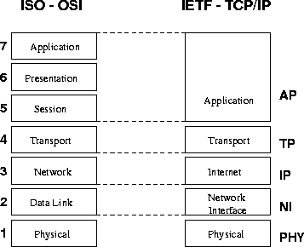
OSI / TCP Layers

Slide 9
IP Addresses v.4
Resides at the network layer, it must be capable of providing coms between hosts on different kinds networks (datalink or physical implementations)
Are usually shown in dotted decimal notation of 32 bits eg 1.2.3.4
00000001 00000010 00000011 000000100
The IP consists of the Network ID and Host ID that are used for routing through ASN’s (Autonomous System Number).

Slide 10
Internet Address Classes
Class A
128 possible network Ids
over 4 million host Ids per network
Class B
16k possible network ids
64k possible host ids per network
Class C
over 2 million possible network ids
about 256 hosts ids per network
Class D is used for multicasting
Class E is used for experimentation

Slide 11
Subnetting
An organization can subdivide it’s host address space into groups called subnets.
The subnet ID is generally used to group hosts based on the physical network topology.
Can simplify routing and security
create a dynamic network

Slide 12
Network Address Translation
Internal hosts can be assigned various internal (non-routeable) addresses eg
Range 1: Class A - 10.0.0.0 through 10.255.255.255 /8
Range 2: Class B - 172.16.0.0 through 172.31.255.255 / 12
Range 3: Class C - 192.168.0.0 through 192.168.255.255 /16
see RFC 1631
Increased the life span of IP v4
can be used for load balancing
can be used for back up links (multihomed)

Slide 13
IP V4 vs V6

Slide 14
TCP/IP Summary
IP: Network layer protocol
unreliable datagram delivery between hosts
UDP: Transport layer protocol
unreliable datagram delivery between processes
TCP: Transport layer protocol
reliable, byte-stream delivery between processes
https://en.wikipedia.org/wiki/Network_security
Notes:
Having said that, it means not only computer information, but all kinds of information like coded letters

Slide 15
Common Network Services
SMTP, POP
Telnet
FTP, TFTP
DNS
Gopher
http
NFS
NIS
X Windows
Rlogin
wms & rtsp
RDP
ssh
etc

Slide 16


Architecture Review
10.1.1.1/192.168.123.1
Remote
Access
10.1.1.2
Internet
10.1.2.1/192.168.123.2
10.1.2.2
10.1.3.1/192.168.123.3
192.168.123.0/24
10.1.3.2
10.1.4.1/192.168.123.4
InternalServers
10.1.4.2

Slide 17
Network Security

Slide 18
What is Network Security?
“Network security consists of the policies and practices adopted to prevent and monitor unauthorized access, misuse, modification, or denial of a computer network and network-accessible resources. Network security involves the authorization of access to data in a network, which is controlled by the network administrator. Users choose or are assigned an ID and password or other authenticating information that allows them access to information and programs within their authority.”
https://en.wikipedia.org/wiki/Network_security
Notes:
Having said that, it means not only computer information, but all kinds of information like coded letters

Slide 19
Network Security Goals
Confidentiality
Guarantees network data is transmitted in a confidential manner
Integrity
Guarantees network data is transmitted in the original representation, unchanged
Availability
Guarantees network data is accessible when it is requested

Slide 20
Confidentiality
Protection against sensitive information from unauthorized disclosure or intelligible interception by unauthorized entities.
Cryptography and access control are used to protect confidentiality;
Encryption call be applied to any layer in the OSI stack, commonly done at the network layer;
There are three forms of access control;
Administrative
Physical
Logical

Slide 21
cont - Confidentiality
Access control is the process of limiting the privileged use of system resources;
Administrative controls based on policies which state the objectives regarding controls over access to resources, hiring and management of personnel, and security awareness;
Physical controls by limiting access to anywhere that contain restricted assets of network nodes and wiring;
Logical controls are the hardware and software means of limiting access which includes access control lists, communication protocols, file system permissions and cryptography

Slide 22
Data Integrity
Ensure that software or information is complete, accurate and authentic
network integrity is when the message is received complete and unmodified between valid source and destination;
Message Authentication Codes, Hash function
Connection integrity can be accomplished by using cryptography and routing control;
Encryption
Vetting, templates
Trace Files, Logs (for recovery)

Slide 23
System Integrity
Configuration Management
Perimeter Defense
Intrusion Monitoring (IDS, A/V)
Trusted Distribution
Policies (AUP, S/W Control, Info Handling)
Personnel Security
Physical Security
Access Control

Slide 24
Availability
Ensure that resources (including information) are available and functional.
Using systems that are designed with
redundancy,
fault tolerance (failover),
Reliability (resilience),
backups & recovery, and
load balancing
End users view availability as being the entire system - applications, servers & network
Since 2000, large web sites Yahoo!, eBay, Amazon, CNN etc the focus of attack for hours/days with Distributed Denial of Service Attack

Slide 25
Network Security Controls
Include network access controls to enforce access policies (e.g., NAC, firewalls, IDPS, web and email content security)
Authentication (e.g., login credential, multi-factor authentication)
Encryption technology secures communications between hosts or networks

Slide 26
Info vs OT Security Triad
Information
Technology
Operational
Technology
Integrity
Confidentiality
VS
Integrity
Confidentiality
Reliability
Resilience
Availability
Availability

Slide 27
Discussion

Slide 28
Defense in Depth

Slide 29
Defense in Depth
Defense in Depth is a concept borrowed from military
The idea is simple:
Use multiple layers of defense to delay an incoming attack by yielding space to buy time
Because attackers must work through different defense layers to access internal resources, the attack has higher chance of being detected, giving the organization time to respond
In network security, defense in depth includes multiple layers of firewalls, DMZ, IDS/IPS, antivirus, web filtering, etc.

Slide 30
Defense In Depth
Like an Onion (a layered approach)
Each layer using different technologies or management controls
Perimeter of Network
Internal Network
Human Factor
30

Slide 31
Defense In Depth
The Perimeter – No Maginot Line
“Do not strike at strength … attack that which is weak…” - Sun Tzu
Routers
Firewalls
IDS’s
VPN Devices
Software
OS, App, DB
DMZ’s and subnets
Perimeter
Defenses
31

Slide 32
Defense In Depth
Internal Network – The inner network safeguards
IDPS, Personal Firewalls
A/V Software
Software Hardening
OS patches etc
Only needed
Services running
Configuration Mgmt
Audits
Internal
Defenses
32

Slide 33
Defense In Depth
Human Factor – The people connected to our systems
Policies, Standards & Procedures
A/V Policy, AUP
Standards of Employee Conduct
BCP Procedures
Awareness Program
Sign AUP Annually
Security tip of the week
Advertise Best Practices
Human
Defenses
33

Slide 34
Discussion

Slide 35
Network Security Threats

Slide 36
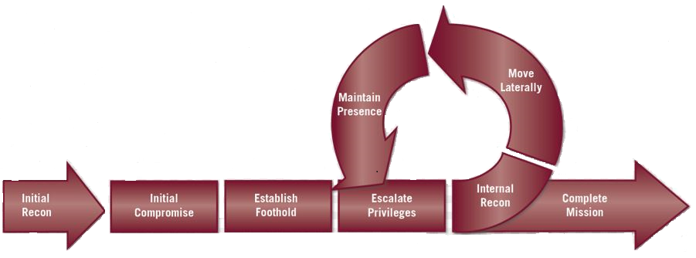
Threats – Enhanced Cyber Kill Chain

Slide 37
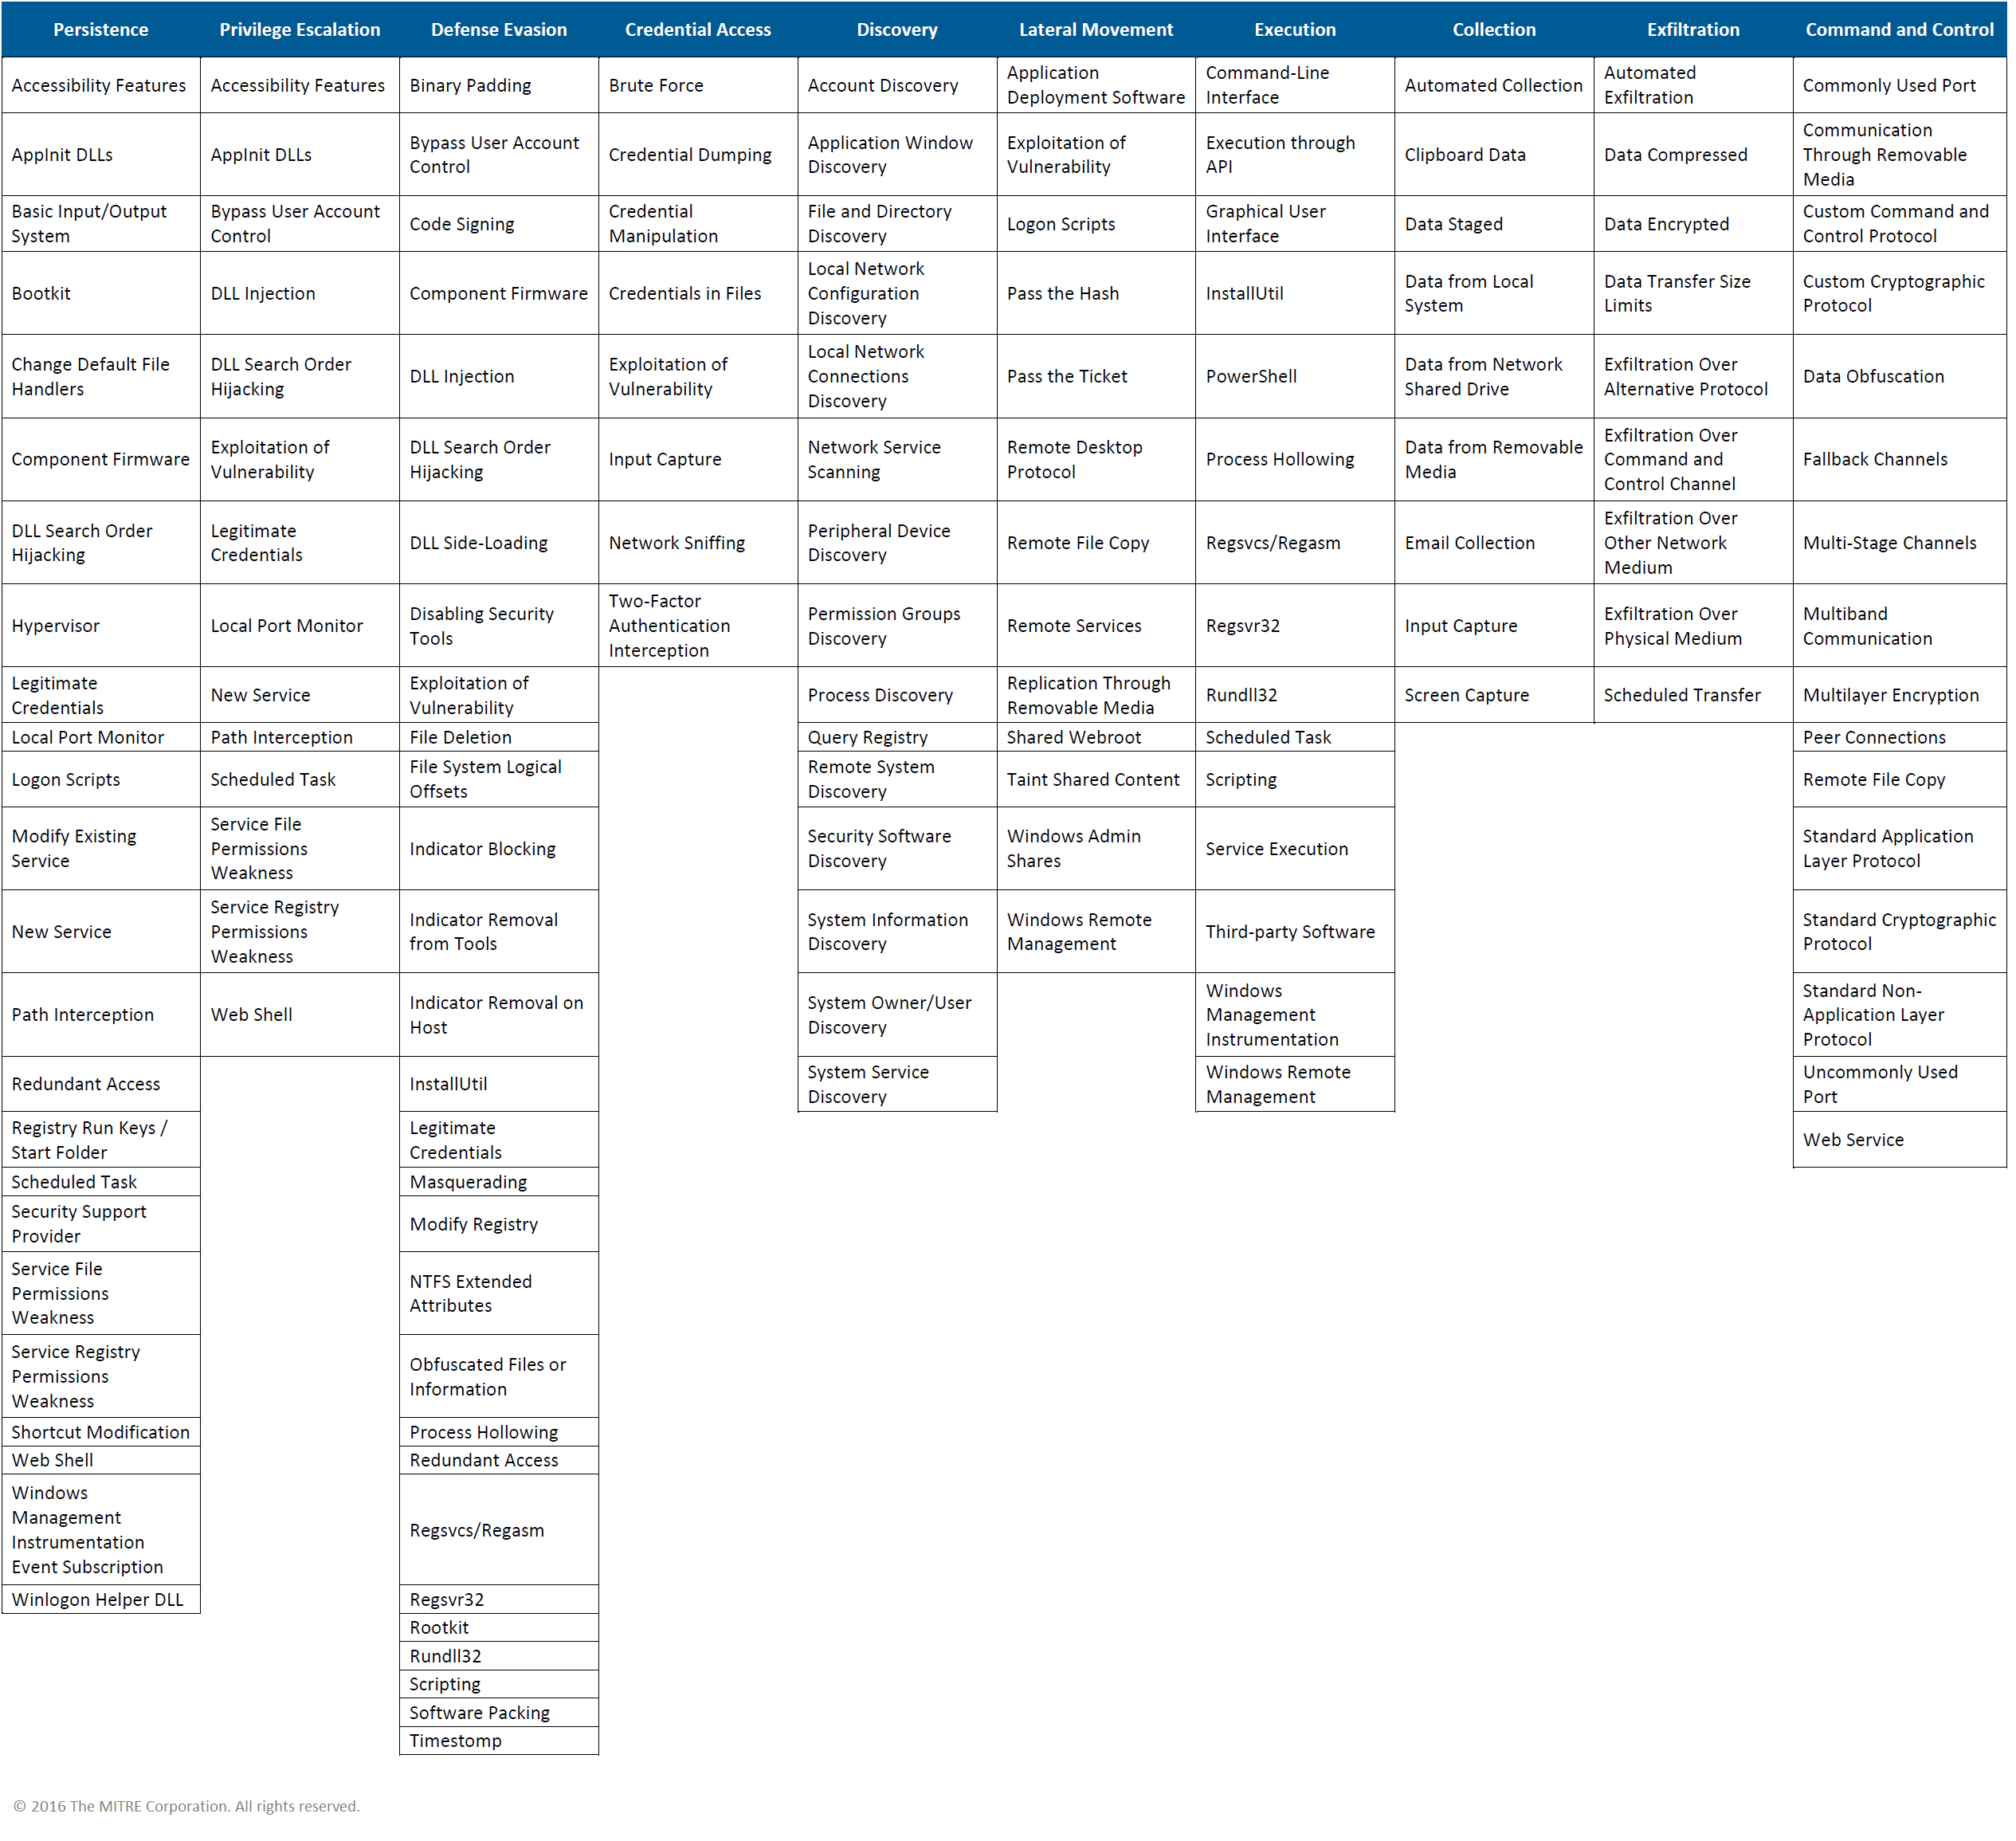
Threats – Mitre ATT&CK Matrix

Slide 38
Common Network Security Attacks
Network Attack
Wiretapping (sniffing)
Port scanners (IP, port etc)
Idle scans
DoS attacks
MAC, IP, DNS, DHCP spoofing
Man-in-the-middle attacks
ARP, DHCP poisoning
VLAN hopping
Smurf attacks

Slide 39
Common Network Security Attacks
Network & OS Attack
Buffer overflows
Heap overflows
Format string attacks
App attacks
SQL injections
Cross-site scripting
CSRF
Phishing

Slide 40
Discussion

Slide 41
Measures of Network Security

Slide 42
Network Security Defenses
Network segmentation / Firewalls
Network & OS Access controls
Behavioral analytics (Network / End Point)
Intrusion Detection System (IDS)
Intrusion Prevention Systems (IPS)
Data loss prevention (DLP)
Antivirus and antimalware (Network / End Point)
Email / Web security

Slide 43
Network Security Defenses
Security information and event management
Virtual Private Network (Net to Net, EP to Net)
Application security
Wireless security
Mobile device security

Slide 44
Discussion

Slide 45
Wired vs. Wireless Networks

Slide 46
Wired Network
Faster speed – up to 40 Gbps
Full duplex, collision free
Harder to sniff traffic
More reliable transmission
Requires physical connectivity, restricts mobility
More secure in general

Slide 47
Wireless Network
Slower speed – up to 2.3 Gbps (theoretically)
Shared medium, prone to collision
Easy to sniff traffic
Prone to transmission errors
Does not require physical connectivity
Less secure in general

Slide 48
Discussion

Slide 49
Network Vulnerabilities

Slide 50
Vulnerability Sources
Vendors
Networks
Avaya, Cisco, F5, Fortinet, Juniper, HP, Palo Alto, etc
OS
IBM, Linux, Microsoft, Oracle
Apps
US-CERT - www.us-cert.gov
CVE Mitre - cve.mitre.org

Slide 51
Identify Network Security Vulnerabilities
Research common network attacks
Perform an inventory of your network devices
Look up vulnerabilities associated with your devices
Employ vulnerability assessment tools
Assess the risks on all your devices

Slide 52
Internal Network Vulnerabilities
Network Perimeter – A line of defense established between the network you manage (your corporate network) and the outside network (the Internet)
Internal network vulnerabilities can be exploited from within the network perimeter
Vulnerabilities on workstations, servers, network devices, storage components, infrastructure nodes, etc.

Slide 53
External Network Vulnerabilities
External network vulnerabilities can be exploited from outside the network perimeter
Vulnerabilities on Internet-facing web servers, services, database, VPNs, firewalls, etc.

Slide 54
Discussion

Slide 55
Security Toolbox

Slide 56
Testing Frameworks
OWASP – Open Web Application Security Project
https://www.owasp.org
PTES – Penetration Testing Execution Standard
http://www.pentest-standard.org
OSSTMM – Open Source Security Testing Methodology Model
http://www.isecom.org/research/osstmm.html

Slide 57
Security Toolbox: Kali
Kali(BackTrack)
https://www.kali.org
Kali used as an offensive security tool to perform penetration testing
Standard tool for security analysts
This course uses Kali to perform most of the offensive network attacks
Download and install Kali into a VM environment
Samurai Security Testing Framework
http://www.samuraistfu.org/
PTF – Penetration Testers Framework
https://github.com/trustedsec/ptf

Slide 58
Kali Demo

Slide 59
Next Lecture
Read
Quiz?
Exam?

Slide 60
© 2017, Southern Alberta Institute of Technology. All rights reserved.
This publication and materials herein are protected by applicable intellectual property laws. Unauthorized reproduction and distribution of this publication in whole or part is prohibited.
For more information, contact:
Director, Centre for Instructional Technology and Development
Southern Alberta Institute of Technology
1301 16 Ave. N.W., Calgary, AB T2M 0L4

